Slide 1
Predicting the Emotions of Tennis Players From Single-Camera Video
Stephanie Kovalchik
2018 Predictive Inference Conference
@StatsOnTheT
skovalchik@tennis.com.au

Slide 2
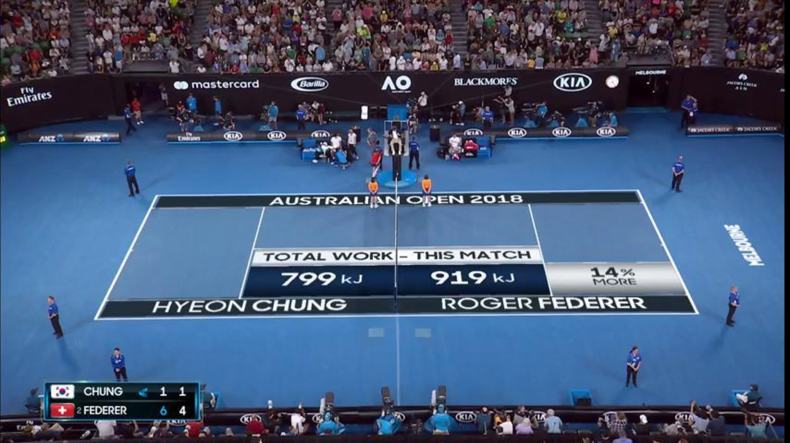

Slide 3
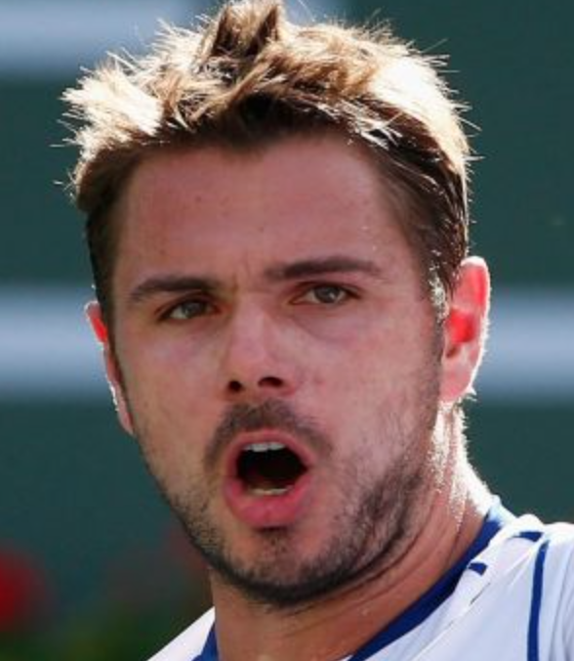
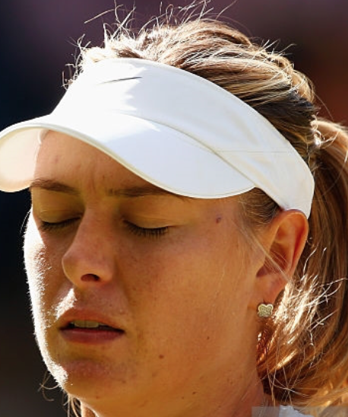
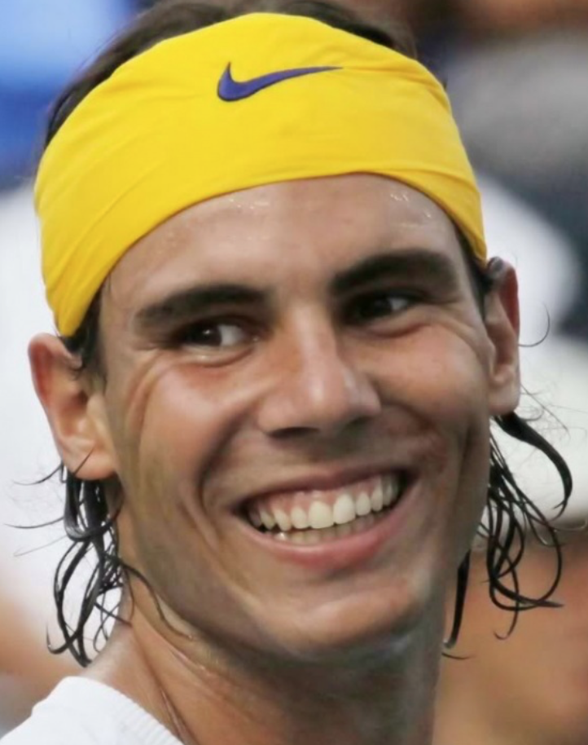
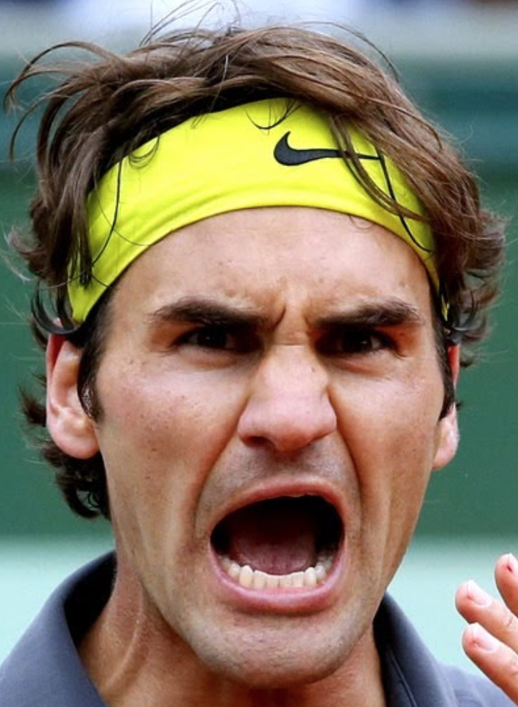
Emotions are a fundamental part of sport.

Slide 4
But what link, if any, is there between what a player feels and how they perform?

Slide 5
WHAT WE KNOW
Conventional wisdom about mentality and performance is based on anecdote and “expert” opinion

Slide 6
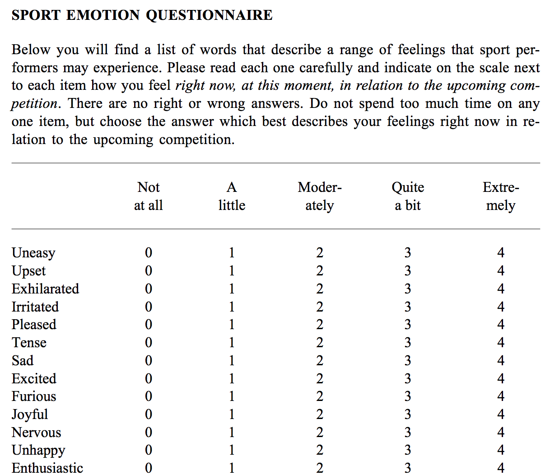
WHAT WE KNOW
Conventional wisdom about mentality and performance is based on anecdote and “expert” opinion
Actual research into player mentality has been largely qualitative (i.e. surveys and recall)
Source: Jones, M. V. et al. (2005). Development and validation of the sport emotion questionnaire. Journal of Sports and Exercise Psychology, 27, 407-431.

Slide 7
To advance mentality research in sport, we need a method to extract quantitative data about emotions at the time they happen.

Slide 8
Over the past decade, machine-based real-time facial recognition has become an achievable goal

Slide 9
OBJECTIVE
Develop an approach for quantifying the emotions of professional tennis players from match broadcasts.

Slide 10
1. Which emotions? 2. How do we build an emotion dataset? 3. Which method can we use to predict emotions? 4. How do we validate our model?
CHALLENGES

Slide 11
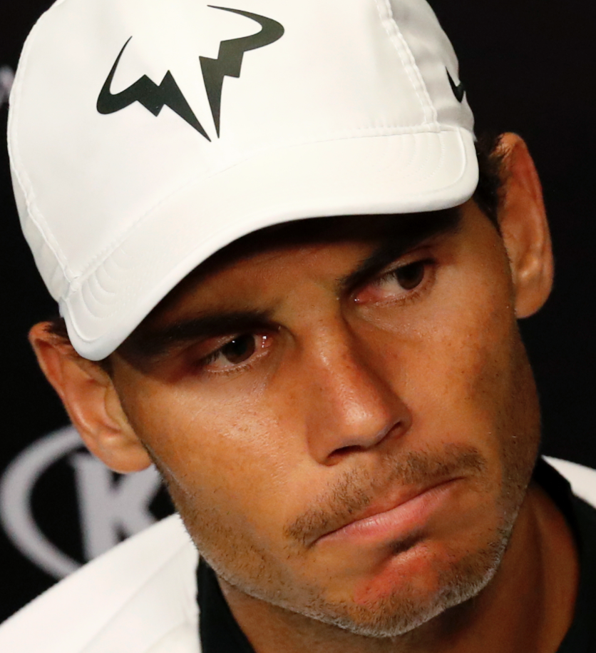
Annoyance
EMOTIONS IN SPORT
Elation
Fired Up
Focus
Which Emotions?
Anxiety
Dejection
Anger

Slide 12
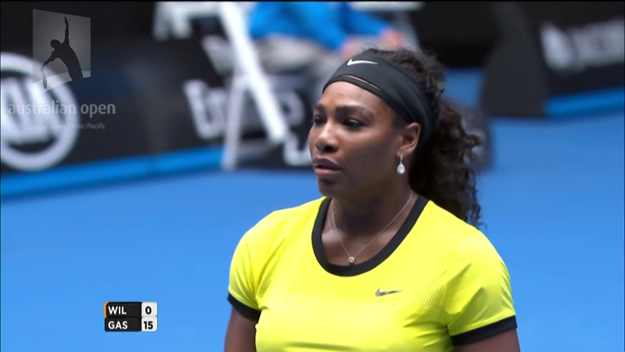
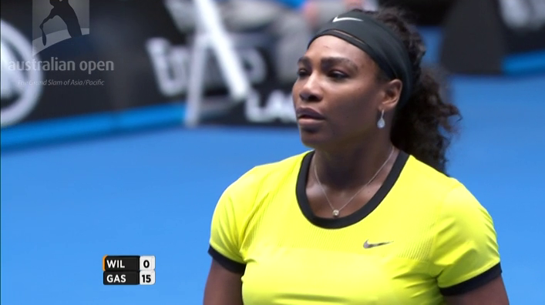
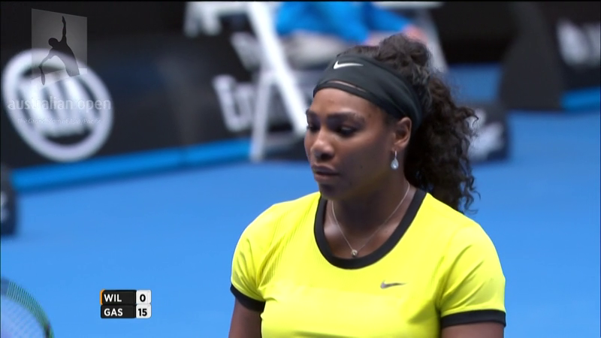
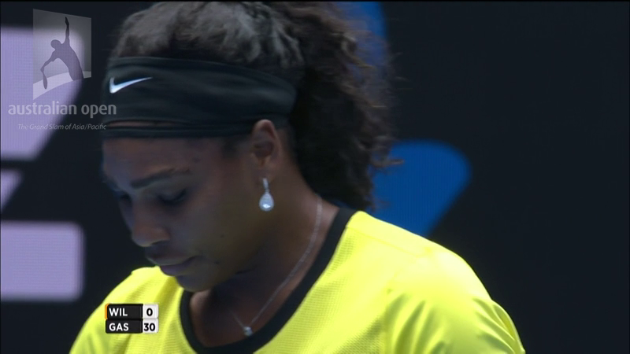
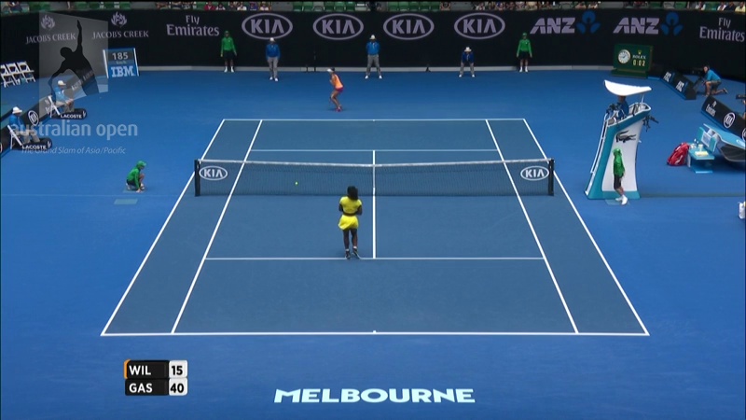
1. Extract a representative set of player images from match broadcasts
EMOTION DATASET
Which Emotions?
ffmpeg
at 1 fps
Exclude non-player
images

Slide 13
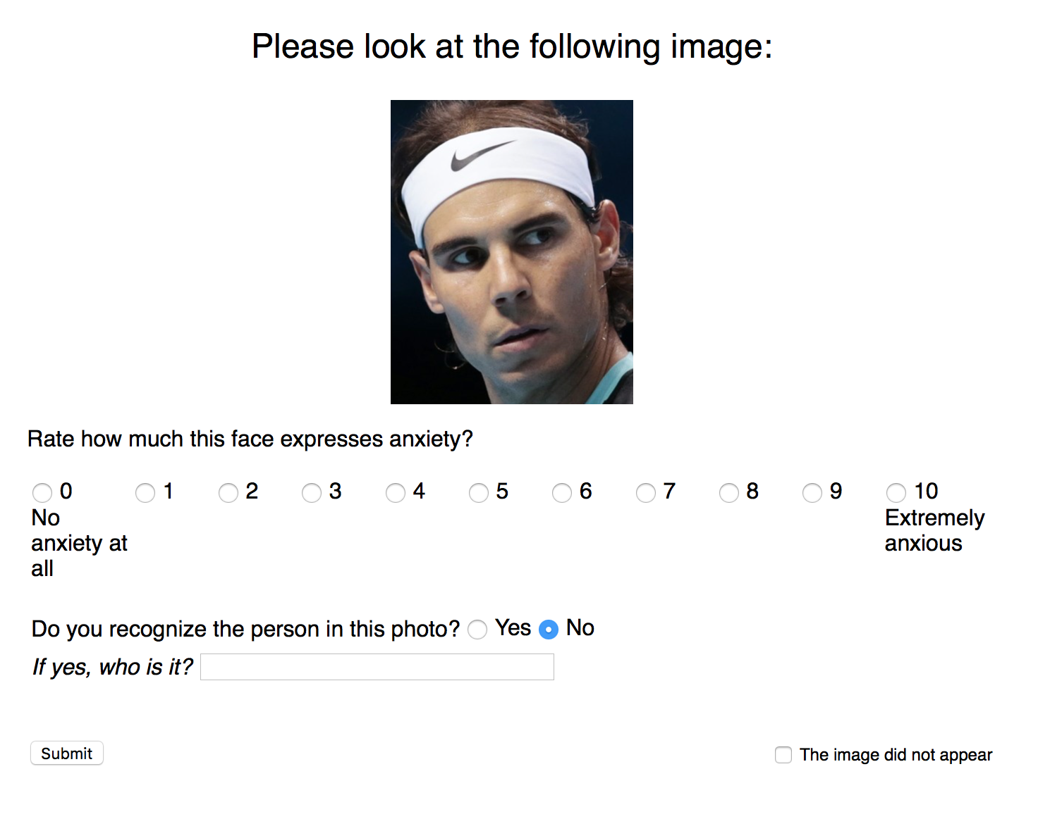
EMOTION DATASET
2. Get reliable emotional labels for each image and get them fast
Which Emotions?
5 qualified workers per image and emotion
MTurkR: Leeper, T. (2016) Crowdsourced Data Preprocessing with R and Amazon Mechanical Turk. The R Journal. Vol 8

Slide 14
MODEL BUILDING
Which Emotions?

Slide 15
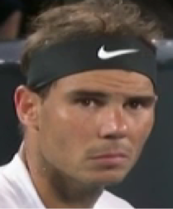
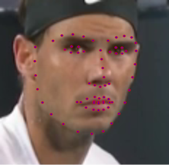
Stage 1. Feature Extraction
MODEL BUILDING
Feature Set 1
openFace
Which Emotions?
17 FAUs
fer2013
Feature Set 2
FACS Emotions

Slide 16
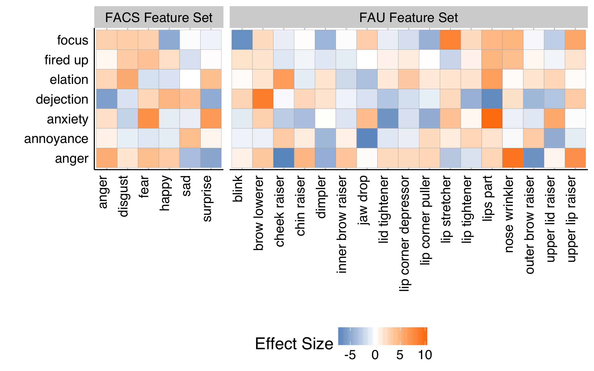

Slide 17
Stage 2. Model Training
MODEL BUILDING
Image dataset (n=1700) split into 70% training and 30% test sets
Training data was further split into 5 cross-validation datasets
Each emotion was trained on 15 different machine learning models
Model selection criteria was lowest out-of-sample RMSE
Training and testing was performed with caret package
Which Emotions?

Slide 18
OUT-OF-SAmple RESULTS
Emotion | Method | FACS | FAUs | FACS + FAUs
Anger | glmboost | 2.83 | 2.91 | 2.82
Annoyance | svmRadialCost | 3.48 | 3.33 | 3.32
Anxiety | kknn | 4.01 | 3.90 | 3.59
Dejection | lasso | 3.93 | 4.02 | 3.82
Elation | svmRadialCost | 2.91 | 2.87 | 2.53
Focus | svmRadialCost | 4.01 | 3.91 | 3.90
Fured up | svmRadialCost | 3.23 | 3.03 | 2.97
Which Emotions?

Slide 19
FACE VALIDITY
Which Emotions?
Roger Federer
(n=908)
Stoic; Focused
Andy Murray
(n=509)
Angry; Annoyed
Novak Djokovic
(n=972)
Intense; Happy; Frustrated
Rafael Nadal
(n=1,031)
Anxious; Intense

Slide 21
PERFORMANCe LINK
Reactive emotions: Association with outcome of previous point
Predictive emotions: Association with outcome of next point

Slide 22
PERFORMANCe LINK
Reactive emotions: Association with outcome of previous point
Predictive emotions: Association with outcome of next point
Associations were assessed with logistic regression models that included the standardized emotion predictions as covariates.

Slide 23
CONCLUSIONS
Emotion capture is a feasible approach for quanitfying the mental side of sport
Further data collection and model refinement needs to be explored
While real-time emotion capture can build on our framework, such a system would have many additional technical requirements

Slide 24
FURTHER READING
Kovalchik, S., & Reid, M. (2018). Going inside the inner game: Predicting the emotions of professional tennis players from match broadcasts. (ID: 5564). MIT Sloan Sports Analytics Conference.
Kovalchik, S., & Ingram, M. (2016). Hot heads, cool heads, and tacticians: Measuring the mental game in tennis (ID: 1464). MIT Sloan Sports Analytics Conference.

